Slide 1
Group E BDM 1024 - Data Technology Solutions Assignment: Lab 1d -MapReduce
Submitted by:
Bibek Shah Shankhar
Anirudh Siddula
Kirandeep Kaur
Kamaldeep kaur Dhami
Davinderjit Singh

Slide 2
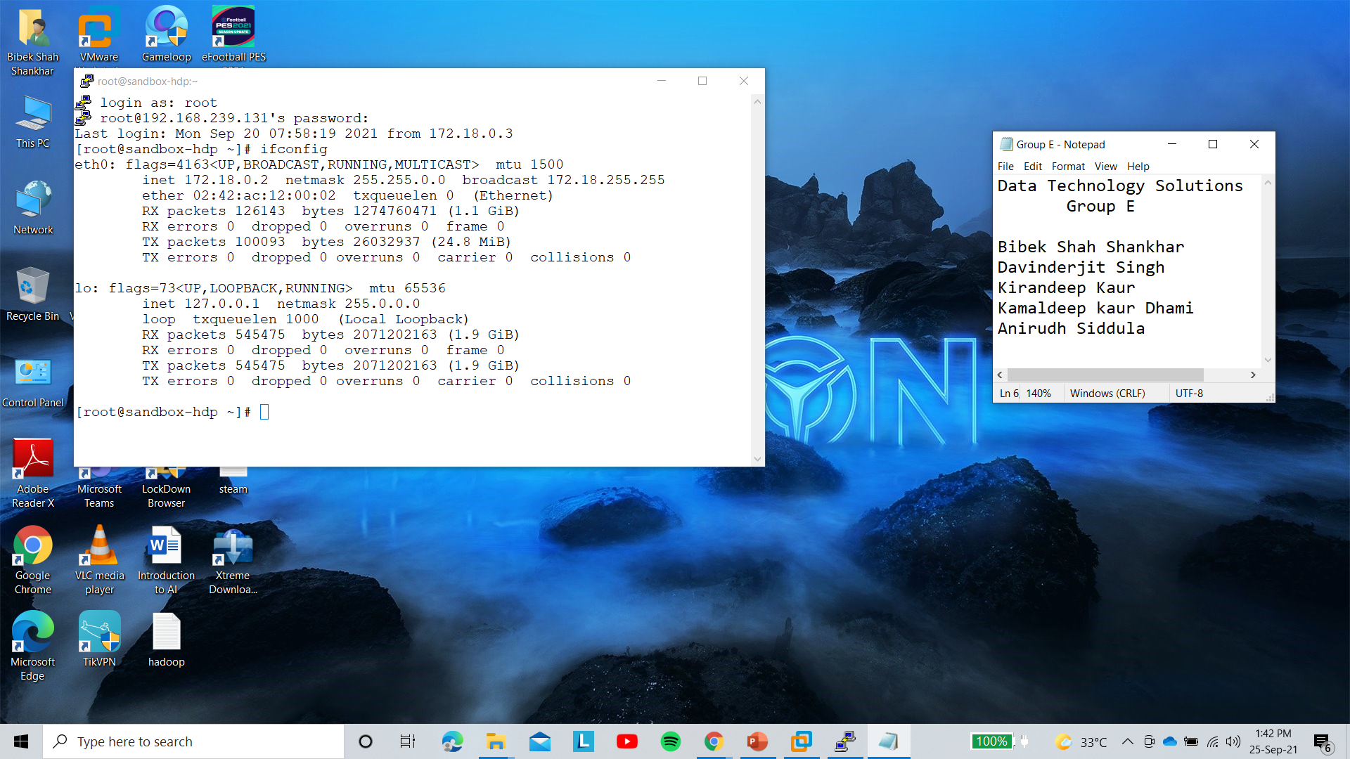
Login To Putty and Checking Ip address.

Slide 3
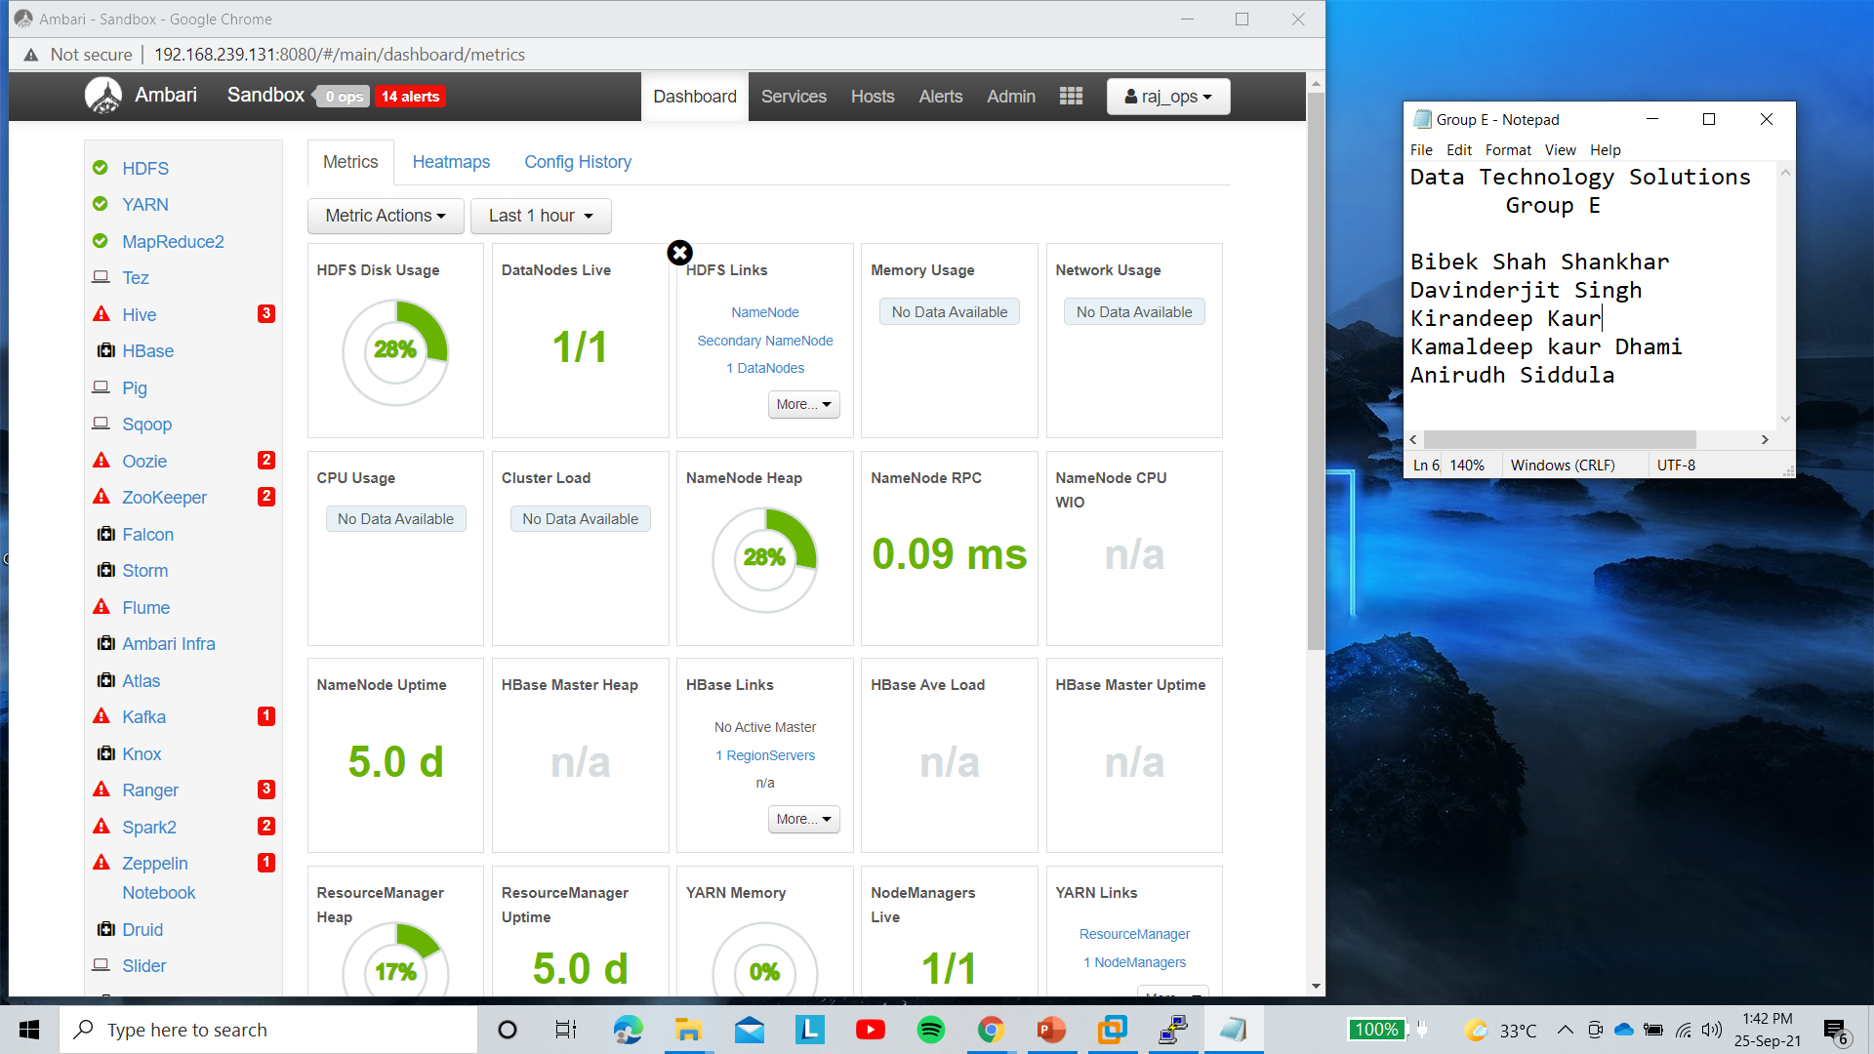
Stopping Unused Services From Dashboard.

Slide 4
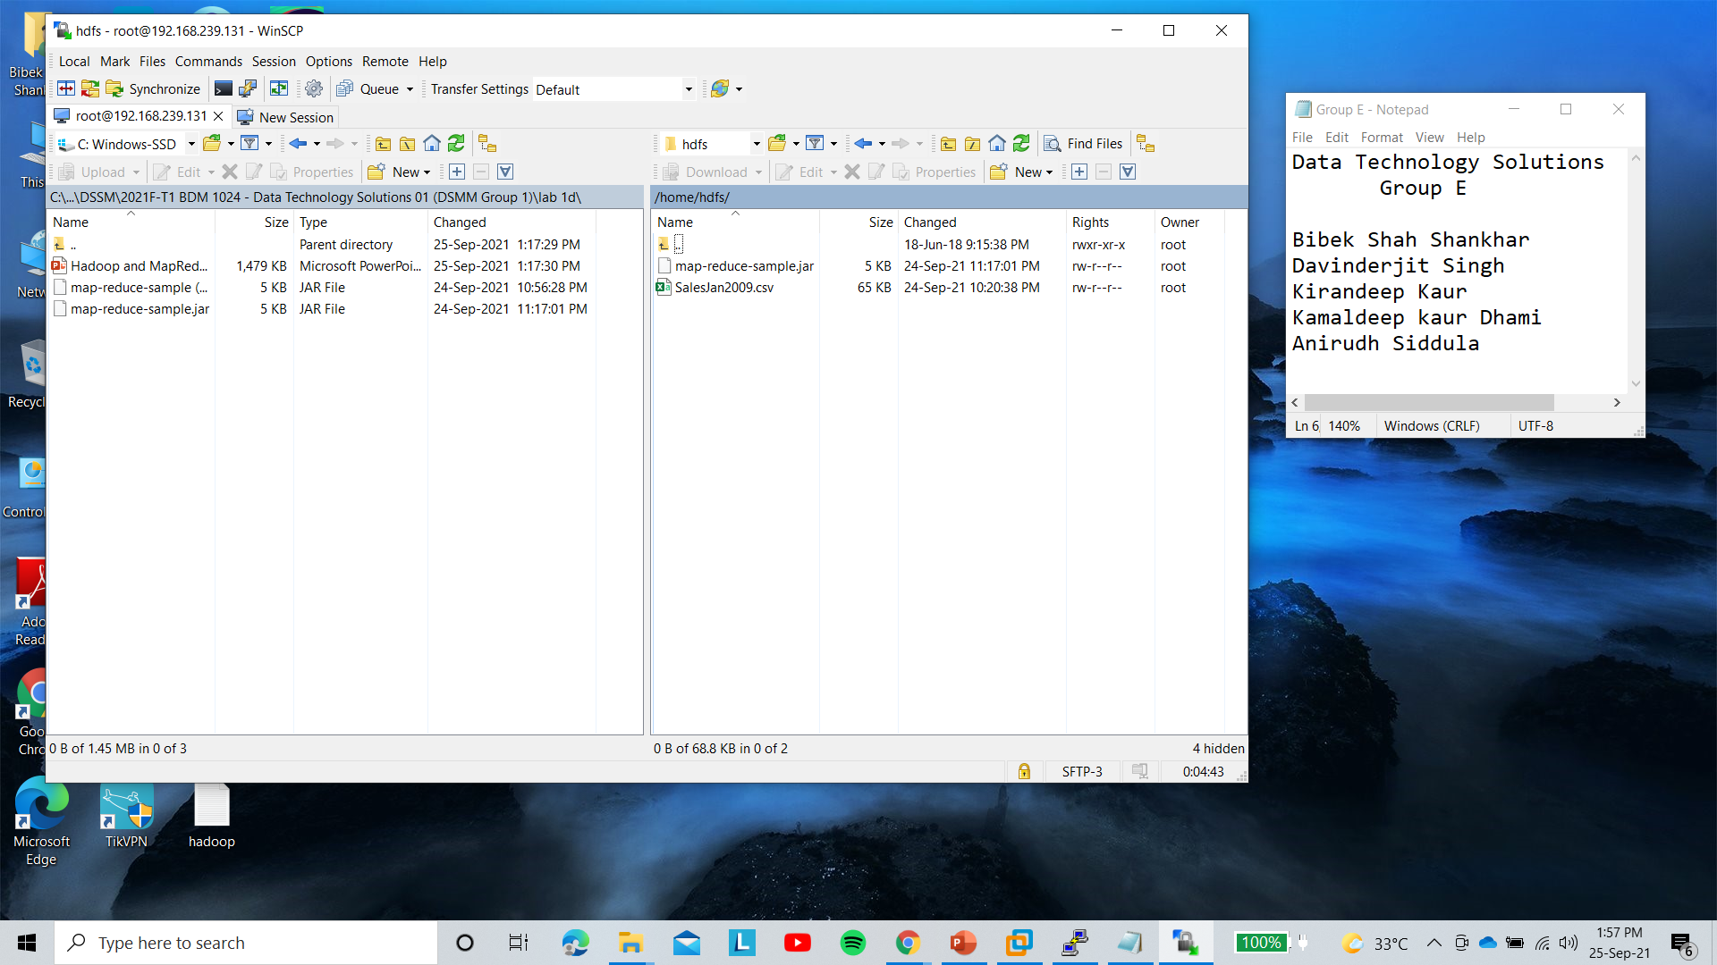
Transferring Local File From System To Hdfs Directory Through WinSCP.

Slide 5
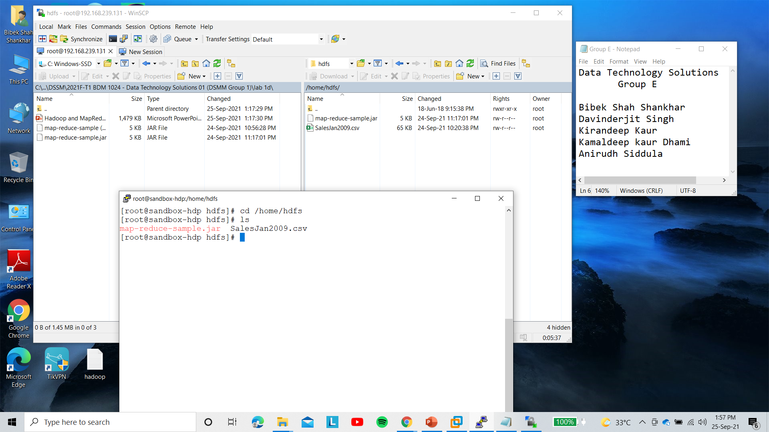
Checking Transferred File from Putty Commands.

Slide 6
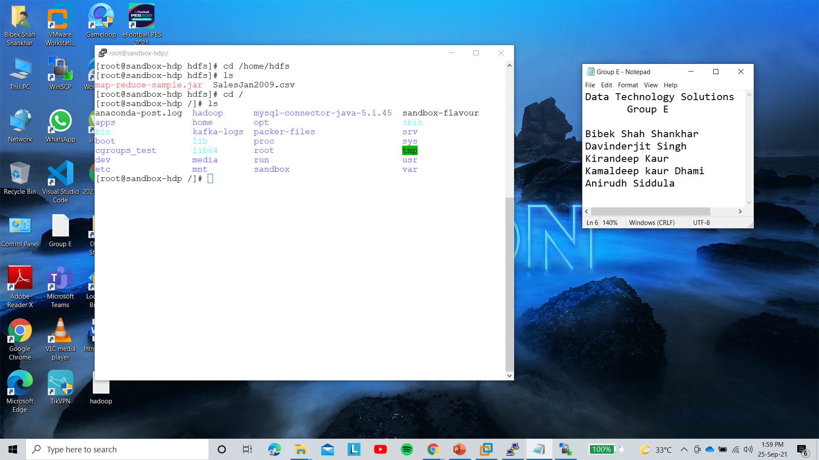
Listing Files in The Directories.

Slide 7
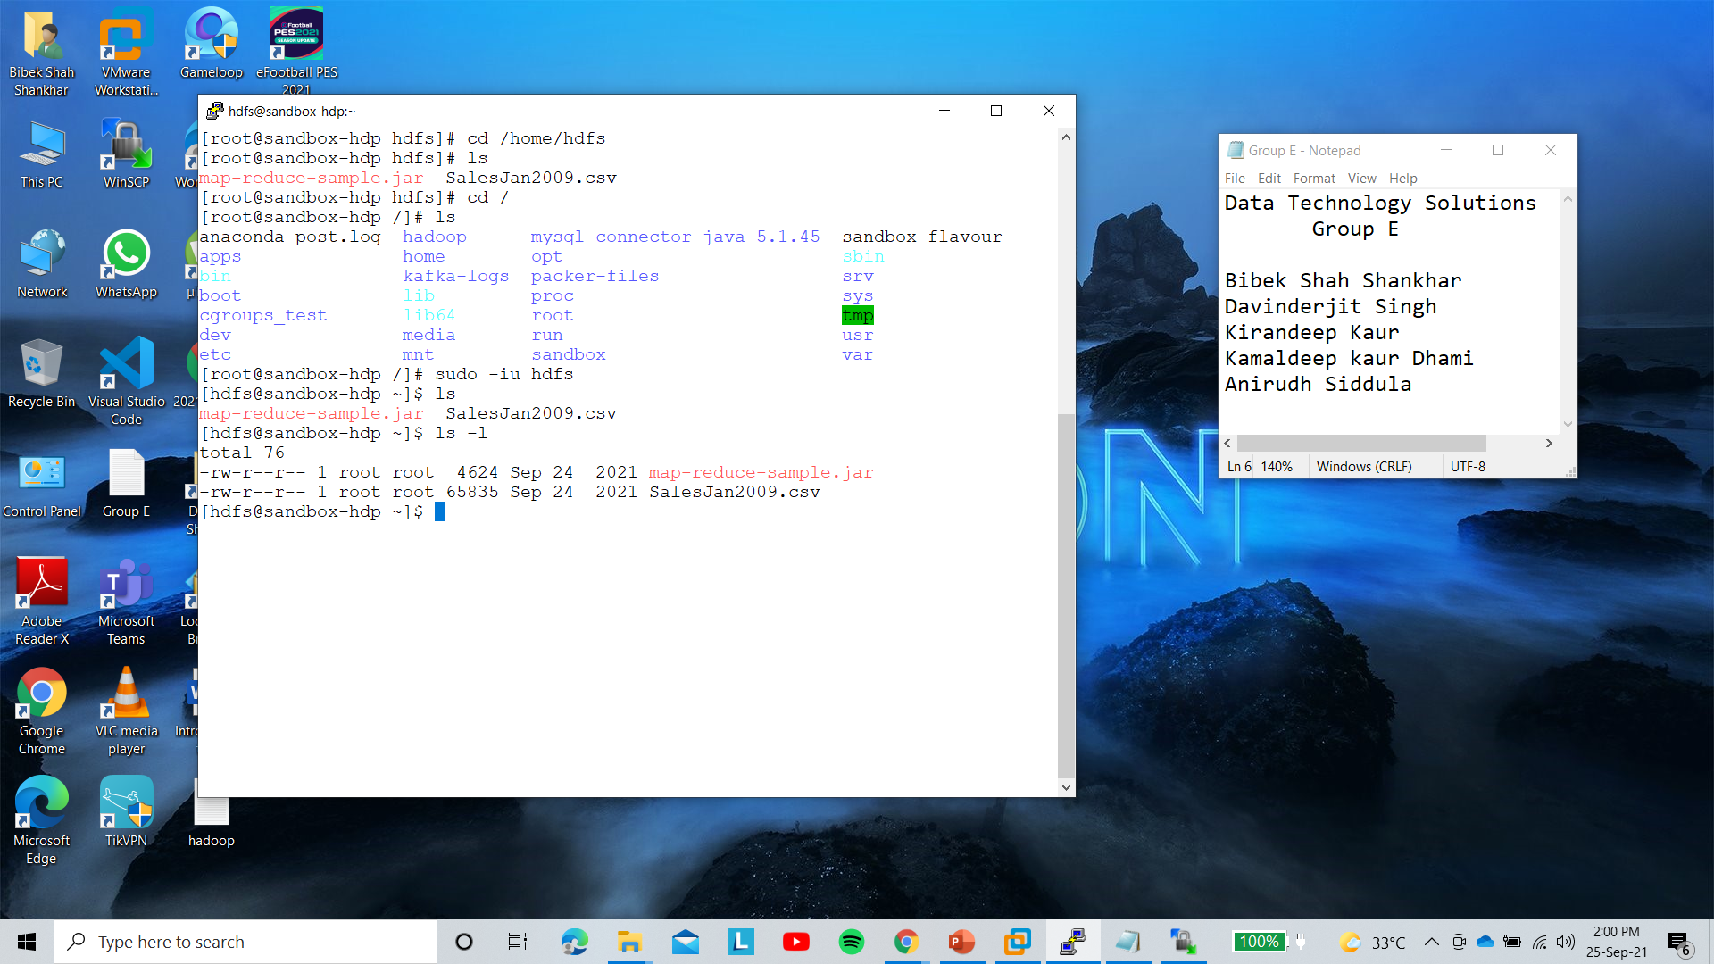
Logging in as hdfs user.

Slide 8
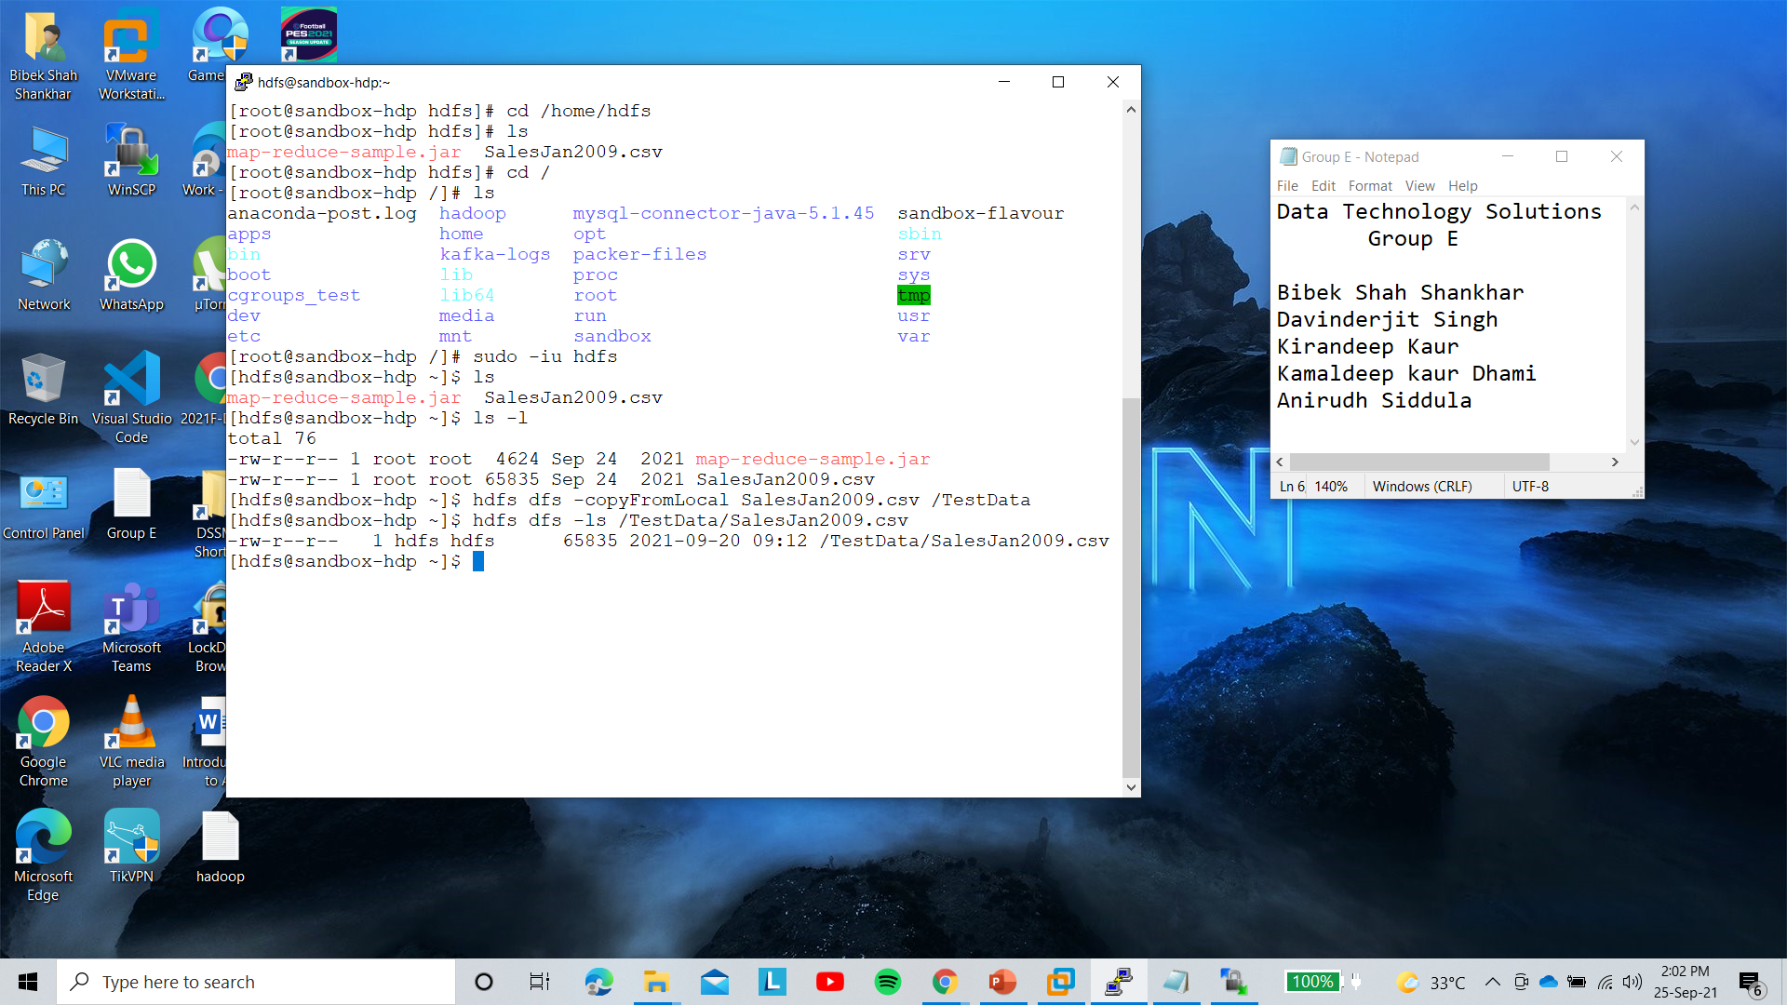
Copying Files from Local System to HDFS and Listing.

Slide 9
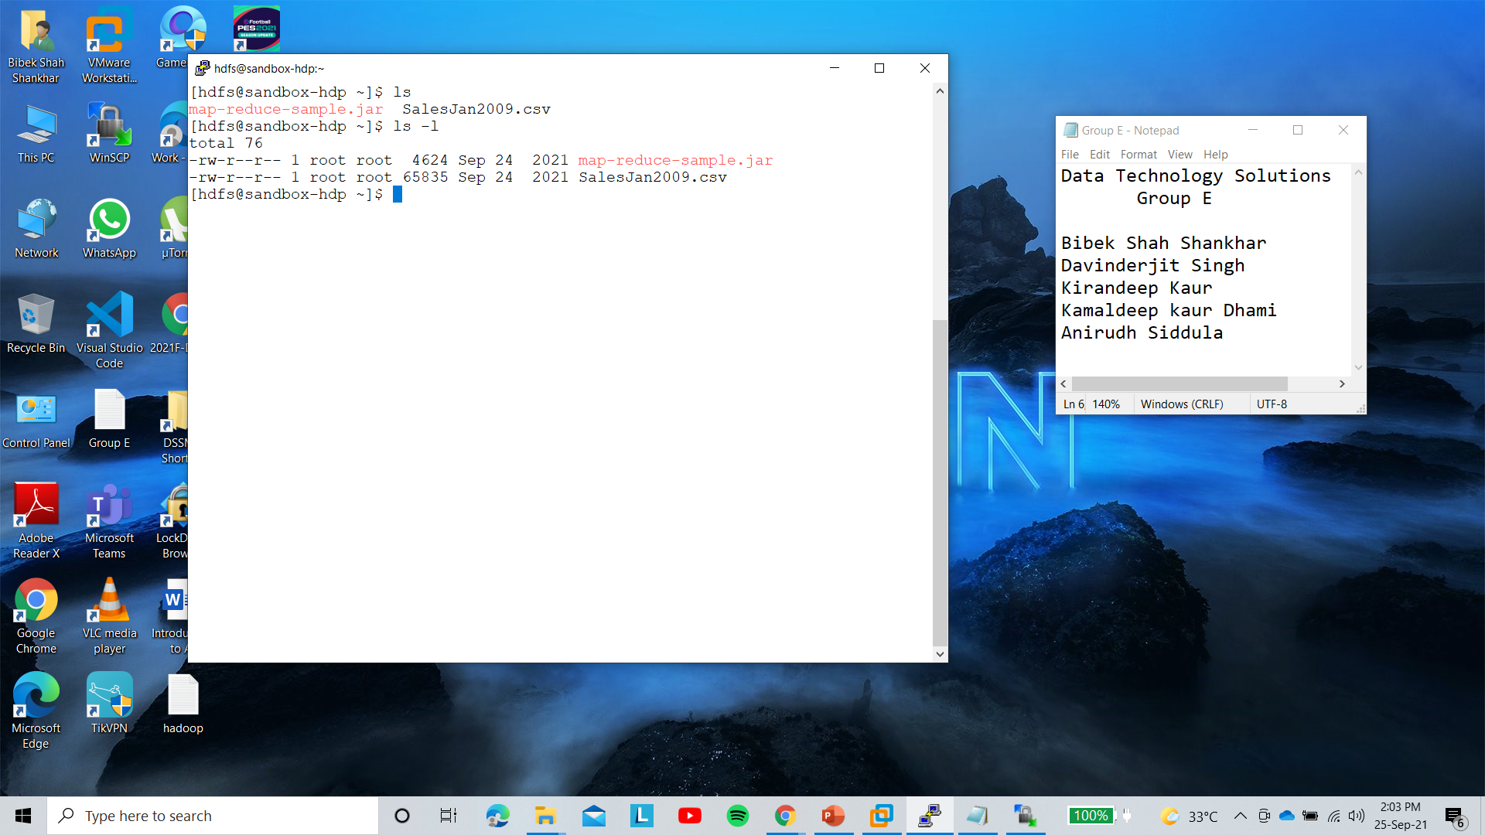
Listing the Copied Files.

Slide 10

Listing files from Hdfs and From TestData Directory Which includes our Project Files.

Slide 11
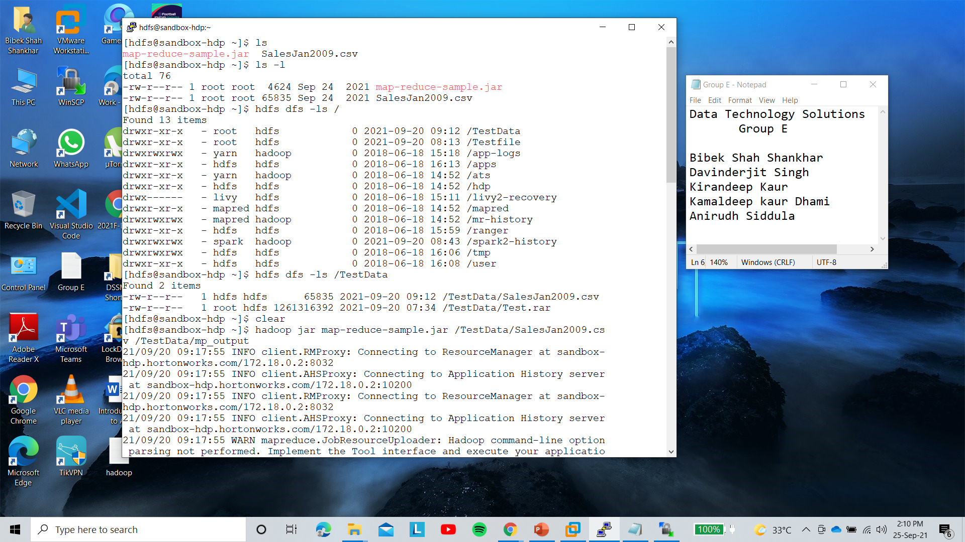
We run the Jar file Which Contains The mapreduce code using Hadoop to execute SalesJan2009.csv and Trying to store Results in TestData/mp_output Directory.

Slide 12
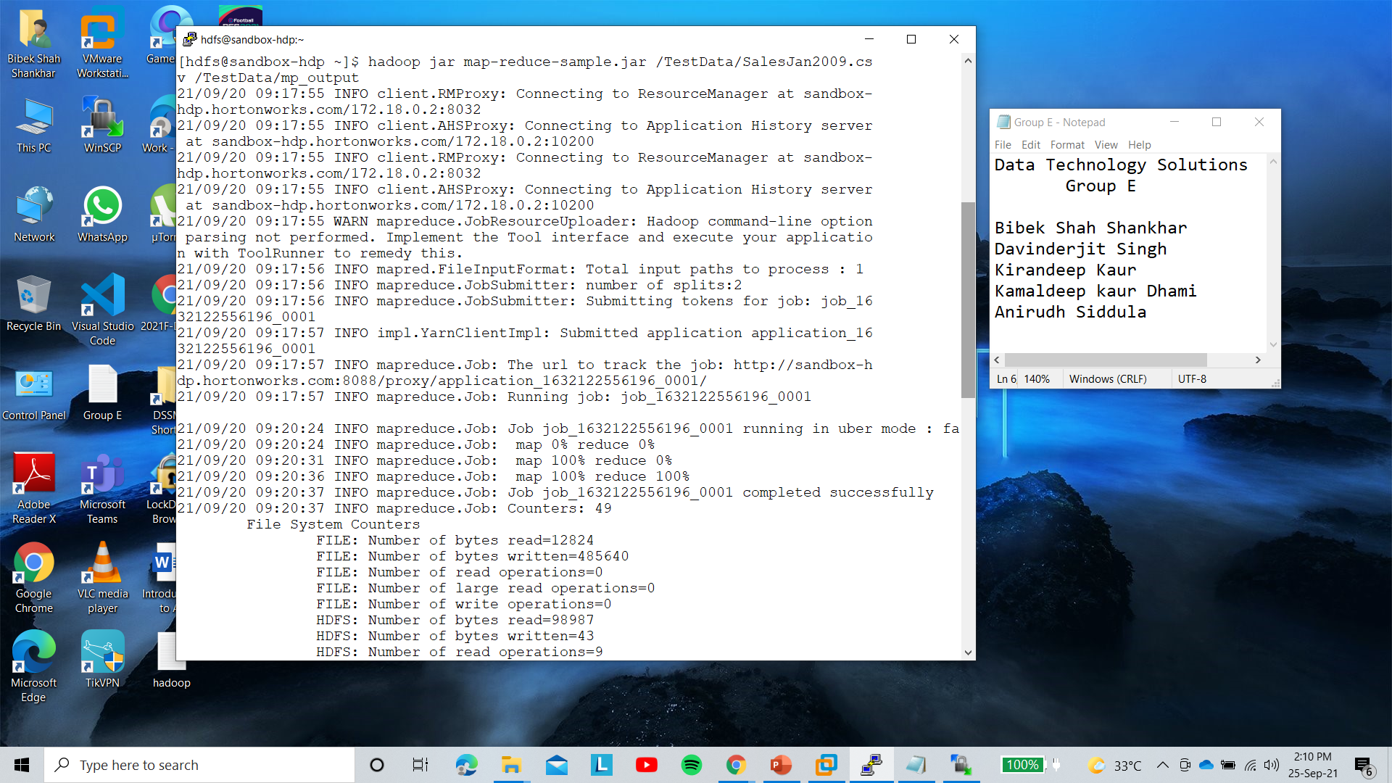
Our map-reduce Code is running and executed Sucessfully 100%.

Slide 13
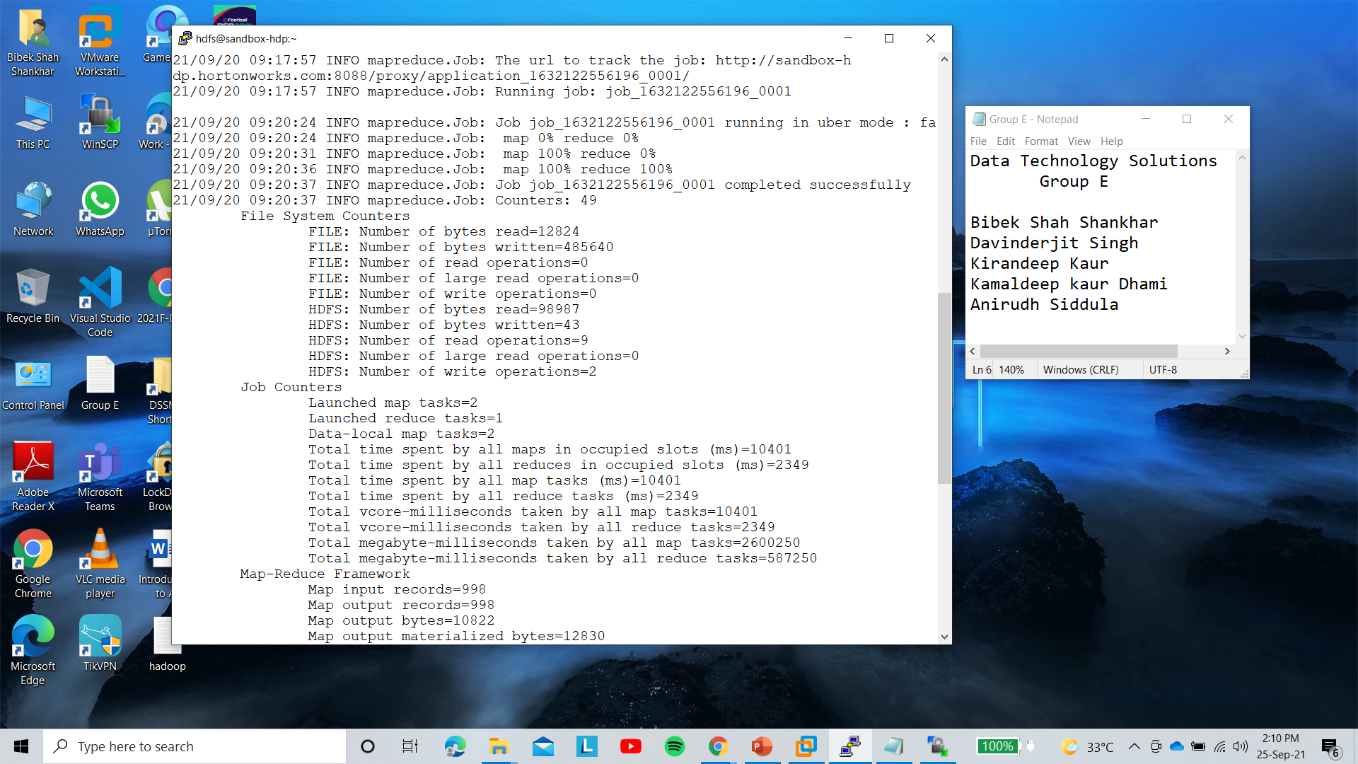
We Have 49 Counters.

Slide 14
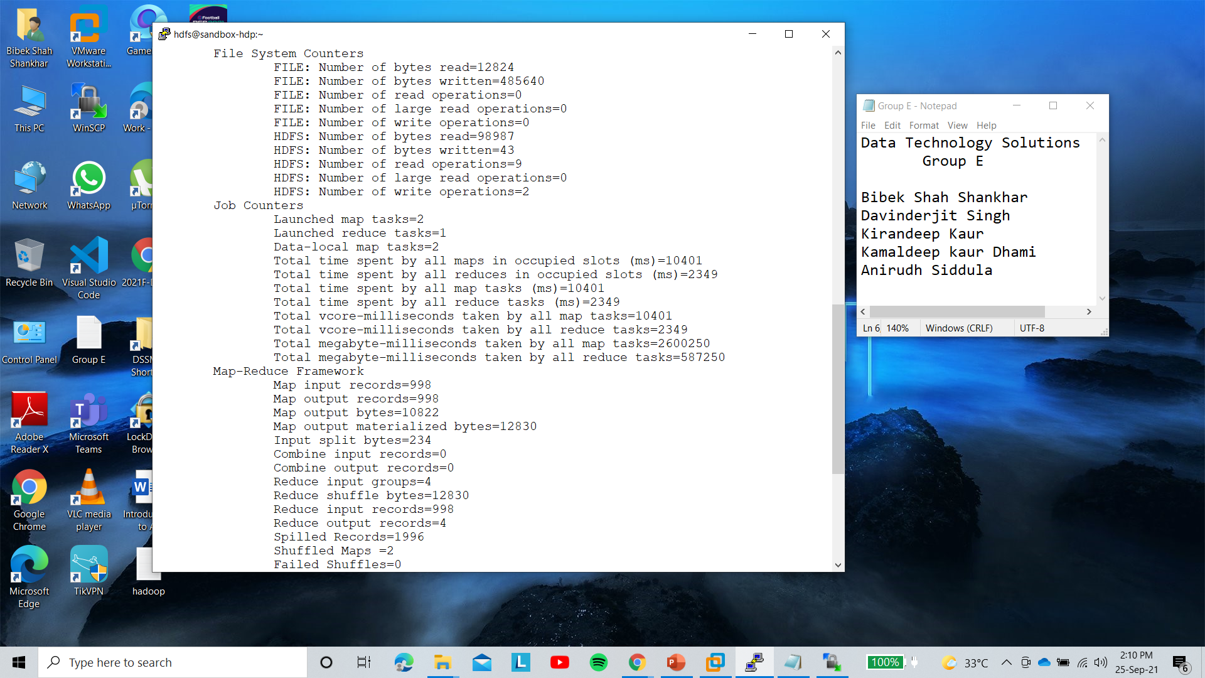

Slide 15

Code Executed Sucessfully and our result is stored in /TestData/mp_output

Slide 16
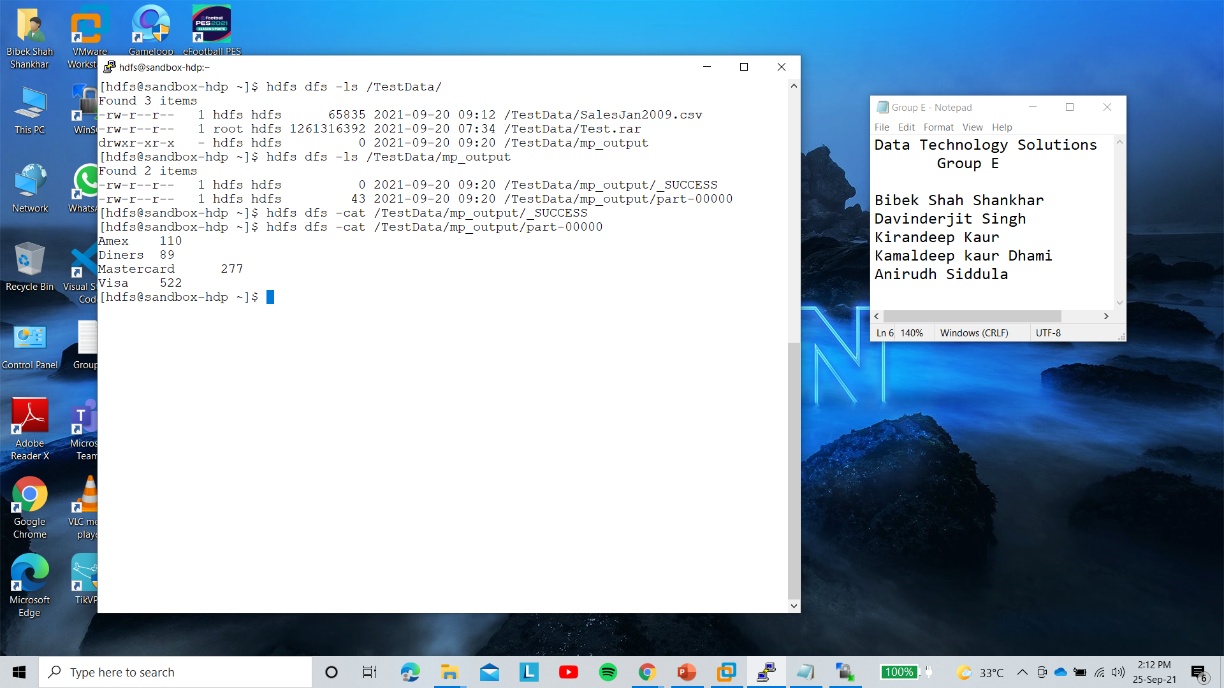
We can see we have a result and Analysis of our mapreduce code.

